Slide 1

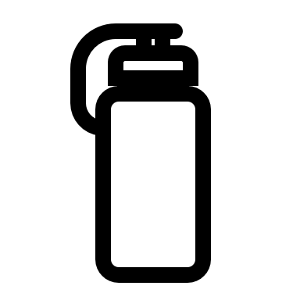



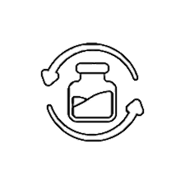
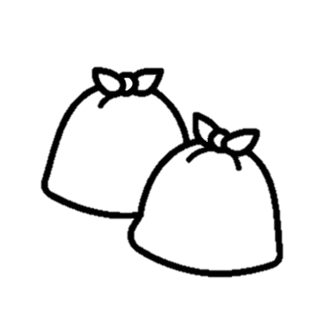





1.
2.
3.
4.
5.
Bring your
own bag.
Use a reusable water bottle
Use your own drinks cup
Use reusable snack pots.
Use your
own utensils.
6.
7.
8.
9.
10.
Skip plastic packaging
Buy in bulk and decant.
Pack a plastic free lunch
Use refill stations.
Share tips with friends.
10 easy ways to use less plastic

