Slide 2
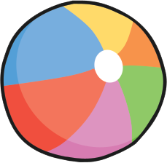
Instructions
This ‘facts about me’ spinner is completely editable. You can use it in a number of different ways. Put in prompts for your students then spin the wheel or use it to choose participants of a game. Fill it with different questions to help students get to know each other and spin the wheel to choose one to talk about.
To start and stop the randomiser wheel, press the red button.
Click to play!

Slide 3
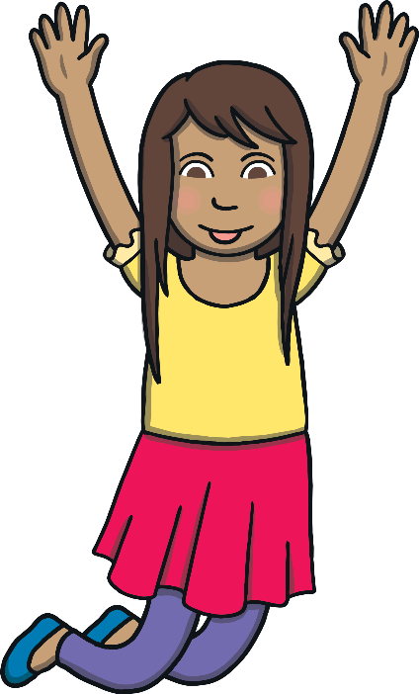


Slide 4
