Slide 1


How Many Squares?

Slide 2
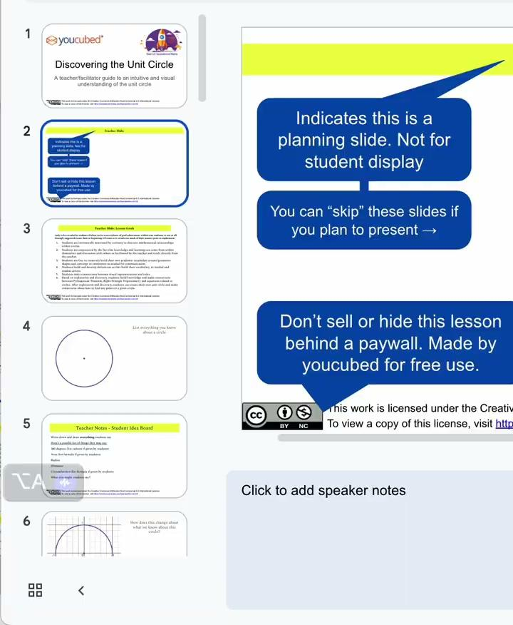

Teacher Slide:
Indicates this is a planning slide. Not for student display
You can “skip” these slides if you plan to present →
Don’t sell or hide this lesson behind a paywall. Made by youcubed for free use.
This work is licensed under the Creative Commons Attribution-NonCommercial 4.0 International License.
To view a copy of this license, visit http://creativecommons.org/licenses/by-nc/4.0/

Slide 3
Teacher Slide: Task Description
In this task students explore different visual puzzles to answer the question, “How many squares?” Students develop convincing arguments about the number of squares they see in each puzzle. Through the exploration of these puzzles and the justification of their solutions students apply foundational understanding of area and multiplication.
Materials:
Puzzle Handout
Paper Tiles (unit square tiles, 2x2 square tiles, L tiles – Optional)
Square Tiles (Optional)
Colored Pencils

Slide 4
Teacher Slide: Mathematical connections
In this activity, students may:
Count squares of different sizes
Organize to count
Visualize squares inside squares
Generate data from visual designs
Identify patterns in data
Identify and describe squares of different dimensions
Compose and decompose squares to make more squares
Define categories of squares by areas and dimensions
Compare areas and dimensions of squares
Use tiling to connect areas and dimensions of squares
Relate area to the operations of multiplication and addition
Name squares regardless of their orientation
See three dimensional layers of squares on a two dimensional image

Slide 5
Teacher Slide: Directions for classroom introduction of the task
Show the image on slide 5 to the whole class. We call this a Shape Talk. Ask students, “How many squares do you see?”
Facilitate student responses as you would a number talk. As they share different answers record them on the board. After you have written all of the different student answers, ask for a student volunteer to defend their answer or a different one. The act of defending your answer is a good mathematical way of working. Students reason and construct their arguments. As they speak they often refine their argument. When students see other students answer and work to explain someone else’s reasoning they are again working in a mathematical way. As students defend their way of thinking, ask for other students to volunteer their agreement or disagreement with the reasoning presented. Go through the different answers as students work to determine the correct answer. For slide 5, the correct answer can be found on slide 15. At youcubed we usually do not share answers. For this lesson starter we thought it would be helpful. You could change to slide 16 and introduce the task in that way, asking students to justify the answer.
Notice when students are skeptical. At some point introduce the role of the skeptic before you begin the main activity. Notes for the skeptic framework and the classroom discussion image are on slides 7 and 8.

Slide 6
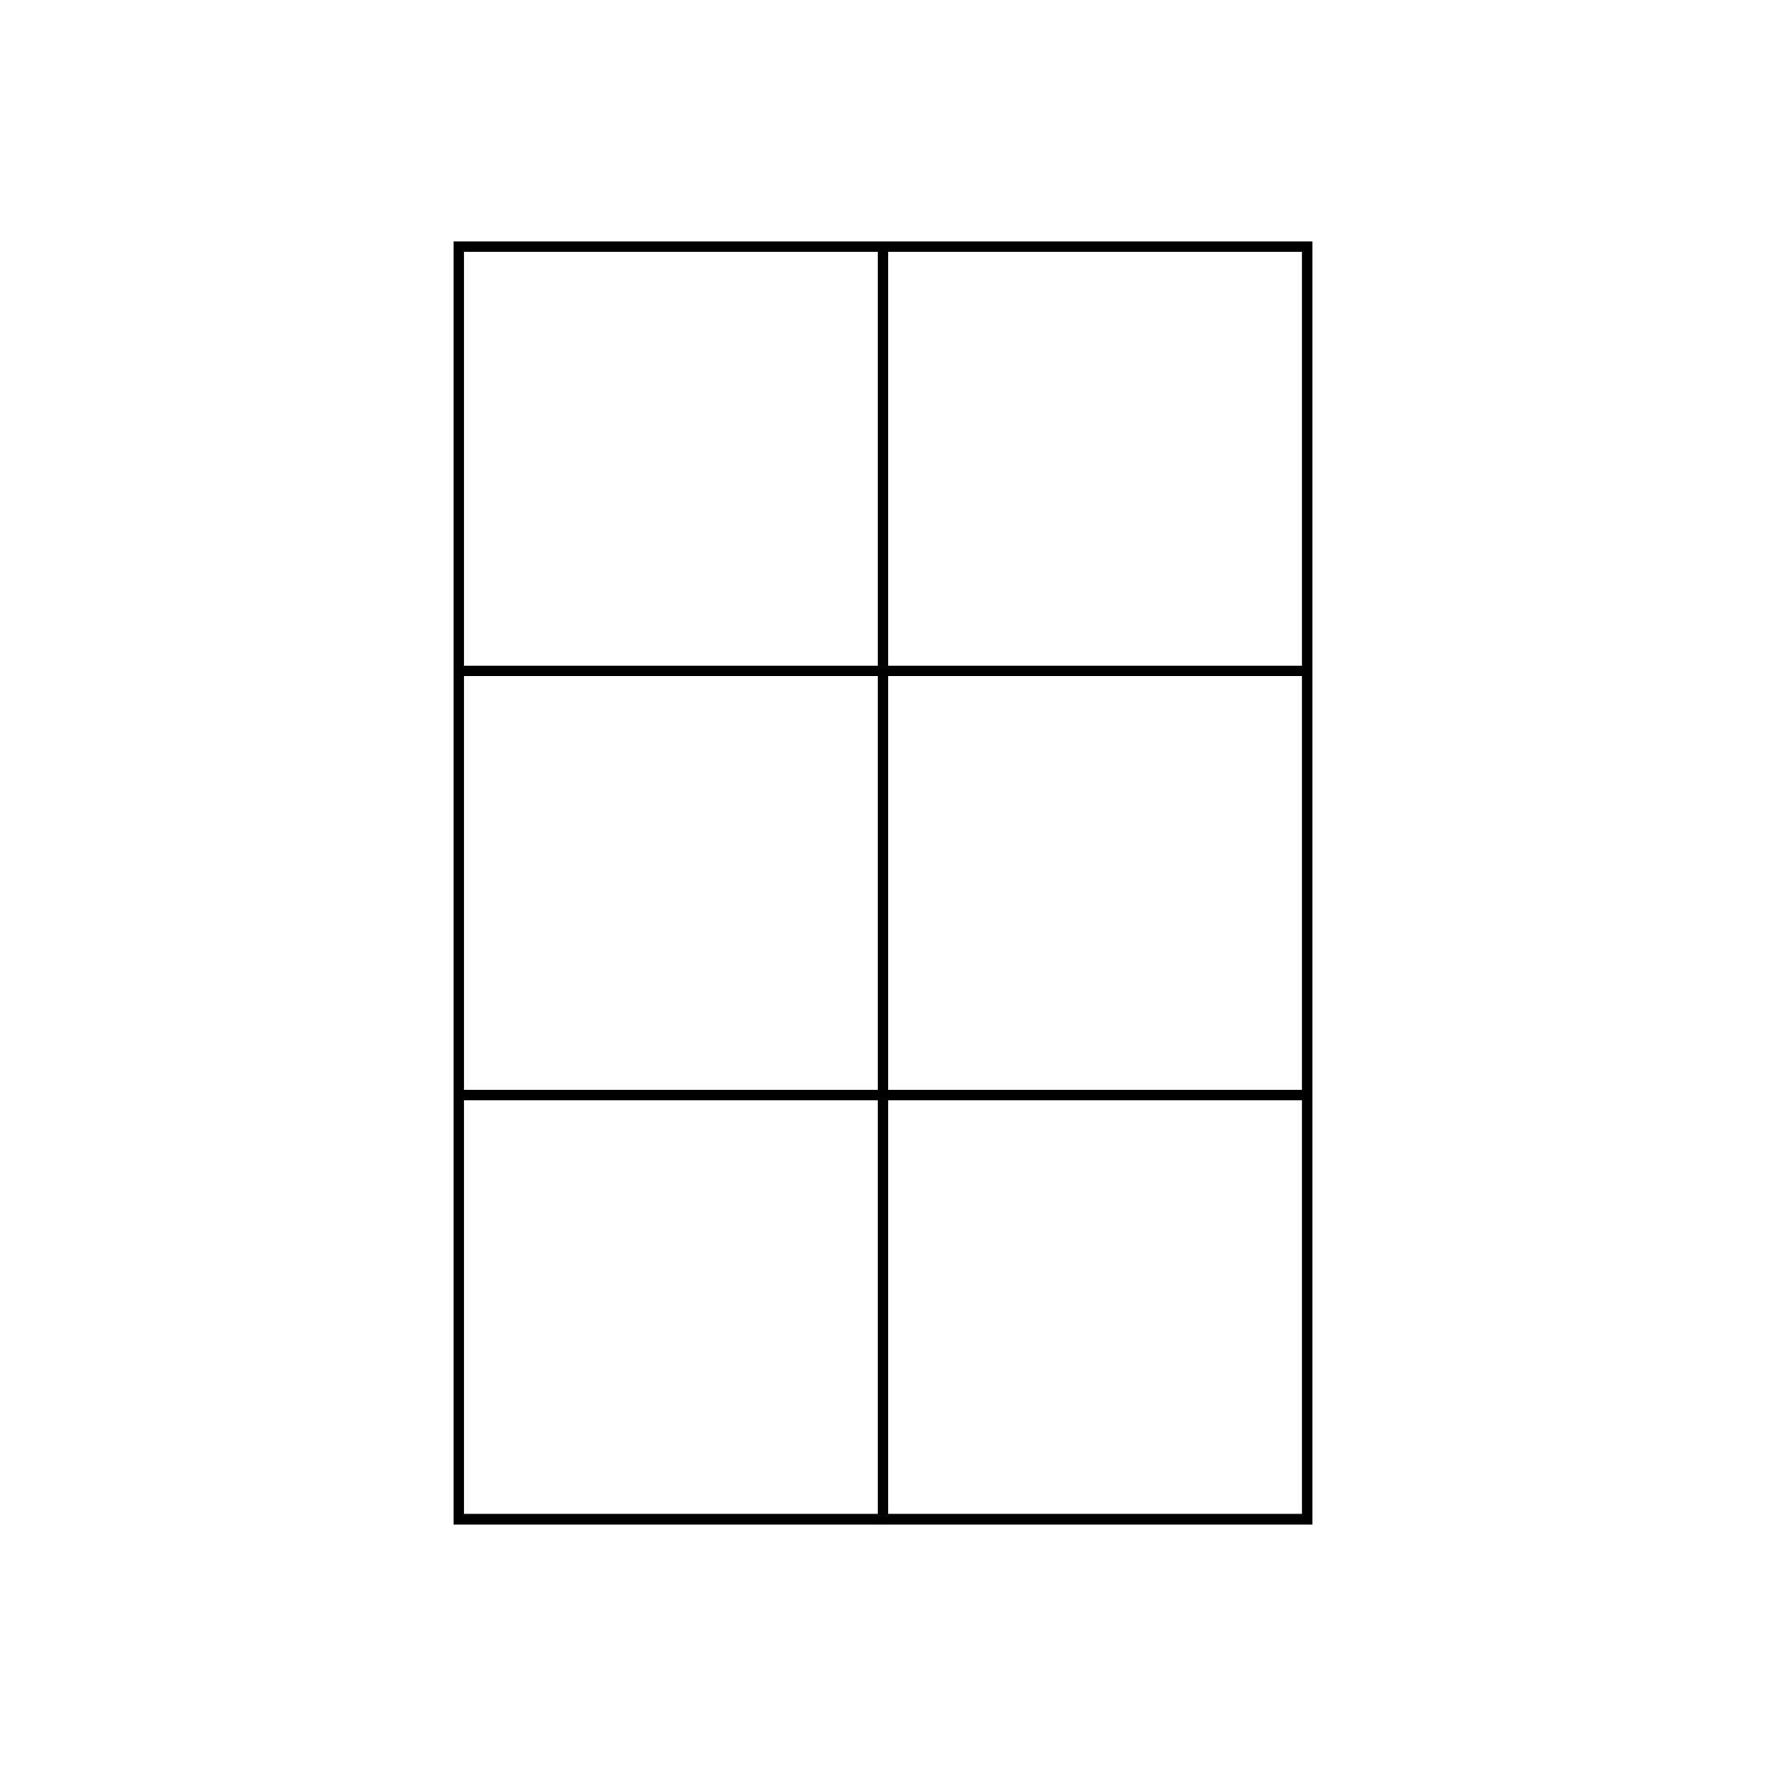
How many squares do you see?

Slide 7
Teacher Slide: The Skeptic Framework
As mathematics educators, we aim to help students go beyond just doing math—we want them to be mathematical. This means engaging with a mathematical problem in ways that are thoughtful and curious. The Skeptic’s Framework supports this by inviting students to analyze a problem and convince themselves of the answer. The next phase is to convince a friend and then a skeptic. This is an important framework because students not only develop and refine their own reasoning but also learn to critique the reasoning of others while they practice ways of communicating mathematically and academically.
Show students slide #7 and explain that working mathematically requires us to convince ourselves, convince a friend and then convince a skeptic. In this activity they will practice first convincing themselves and then to convince a skeptic. For each image both students work out what they believe to be the answer. Then one students presents their argument. The other students role is to be a skeptic by asking questions and pushing the student to refine their argument.
You can direct students back to the introduction image on slide 5 and point out ways students were convincing and skeptical.

Slide 8
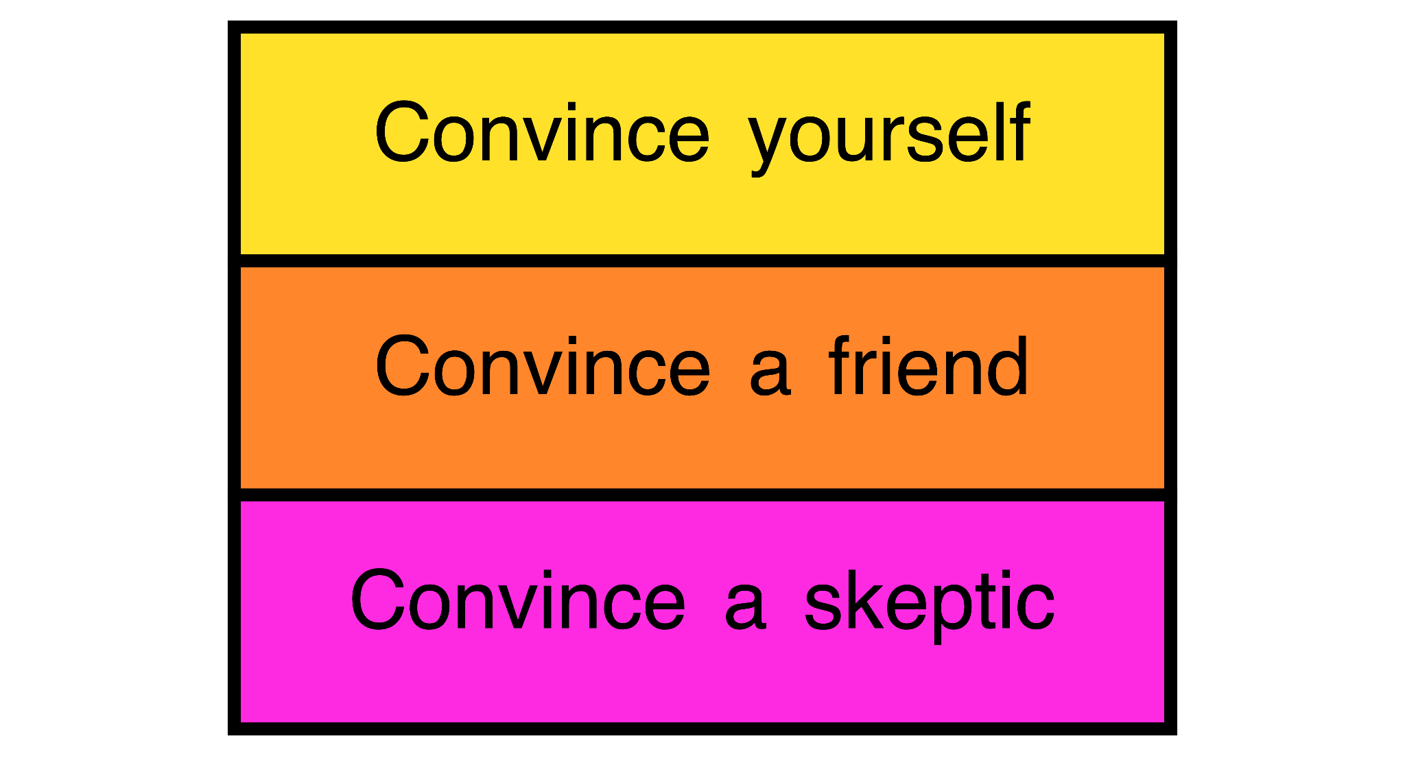
The Skeptic Framework

Slide 9
Teacher Slide: Directions for the activity
Give students the How Many Squares? Handout of your choice. We are providing one page with all 4 puzzles and individual pages where each puzzle is duplicated 4 times so students can annotate images with color to build their own understanding and plan ways to convince their skeptic. (Puzzle 1, Puzzle 2, Puzzle 3, Puzzle 4) If you have square tiles or a similar manipulative students would be helped by building visual proofs. If you want all of the handouts in one document you can download it here.
Student 1 works out the answer to Puzzle 1 and Student 2 works out the answer to Puzzle 2. Both are working to convince themselves and may choose to discuss their strategies with each other as they work.
When they have finished convincing themselves student 1 presents their solution of puzzle 1 to the student with puzzle 2. Student 2 listens carefully and ask clarifying questions that help student 1 push their understanding. Student 2 be mindful of the questions they need answered so they understand and are convinced that student 1 has solved the puzzle.
After both students 1 and 2 are finished with puzzle 1 it is student 2’s turn to present their argument for Puzzle 2. Student 1 now acts as the skeptic.
Students can continue with Puzzles 3 and 4.

Slide 10
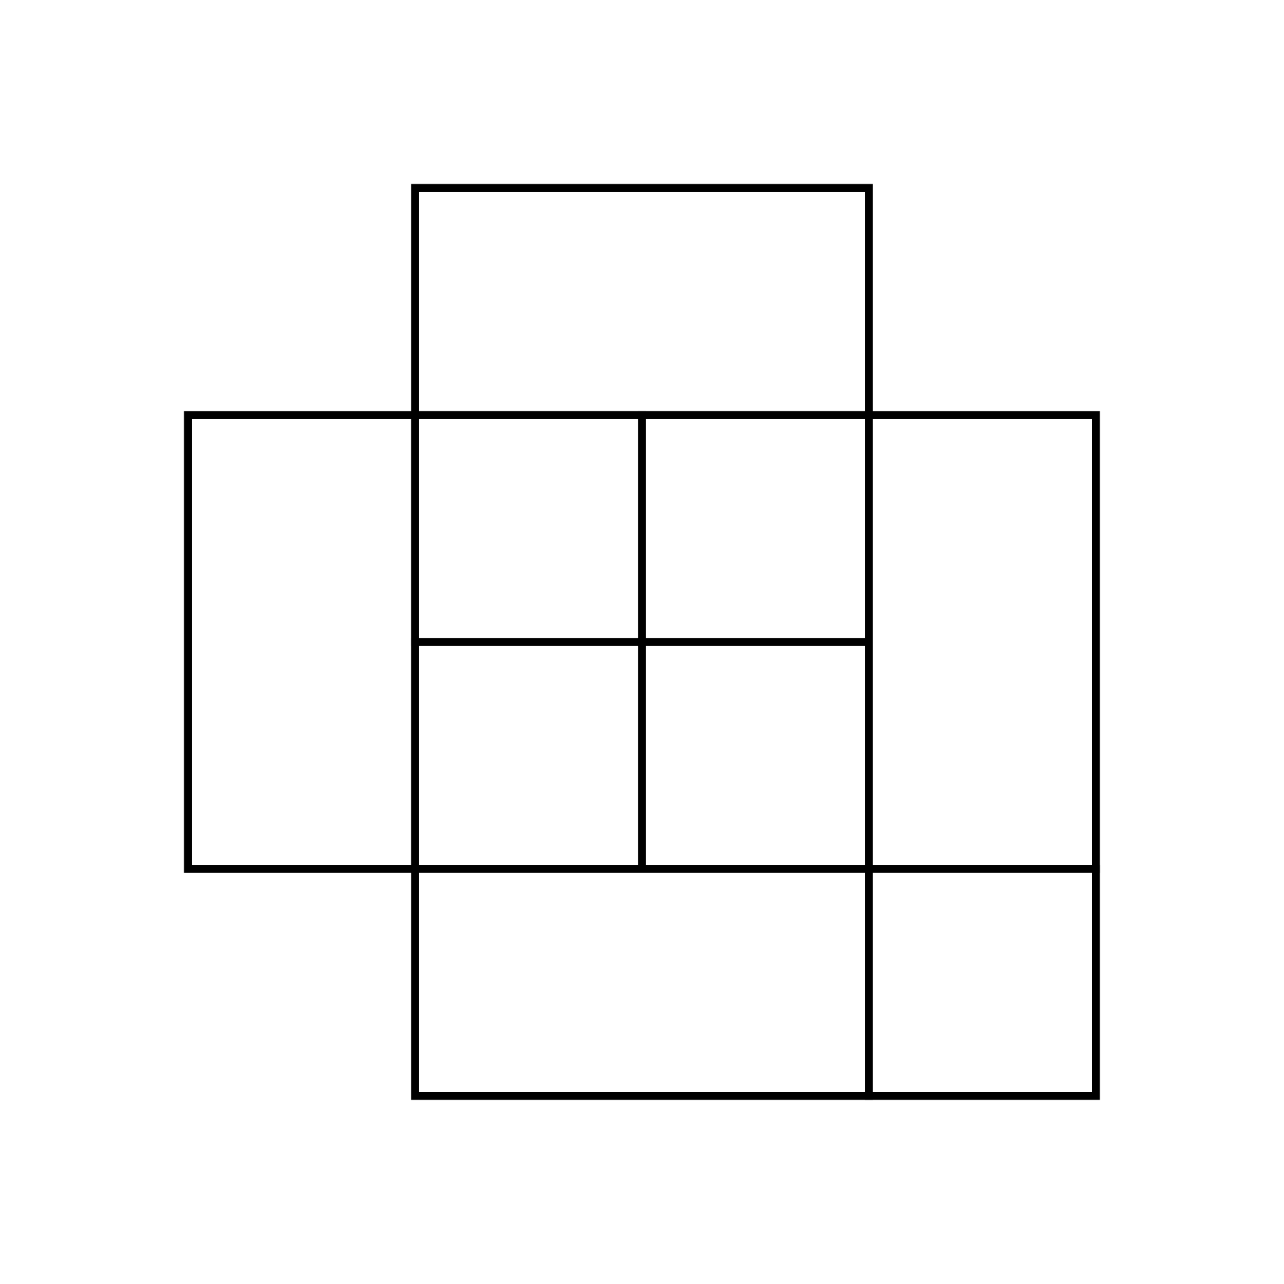
Puzzle 1

Slide 11
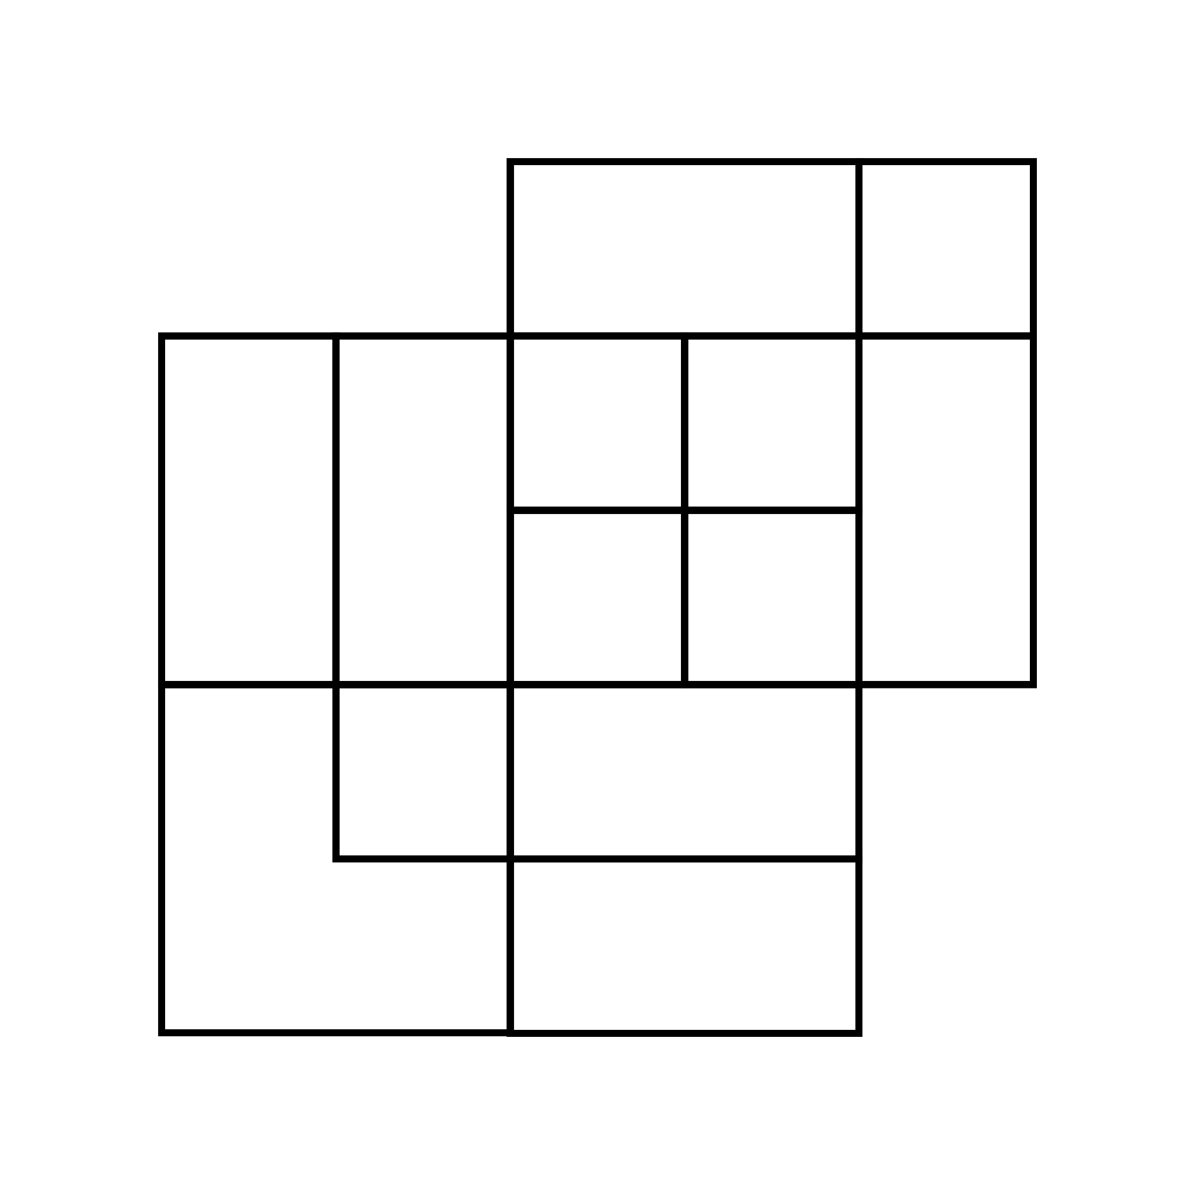
Puzzle 2

Slide 12
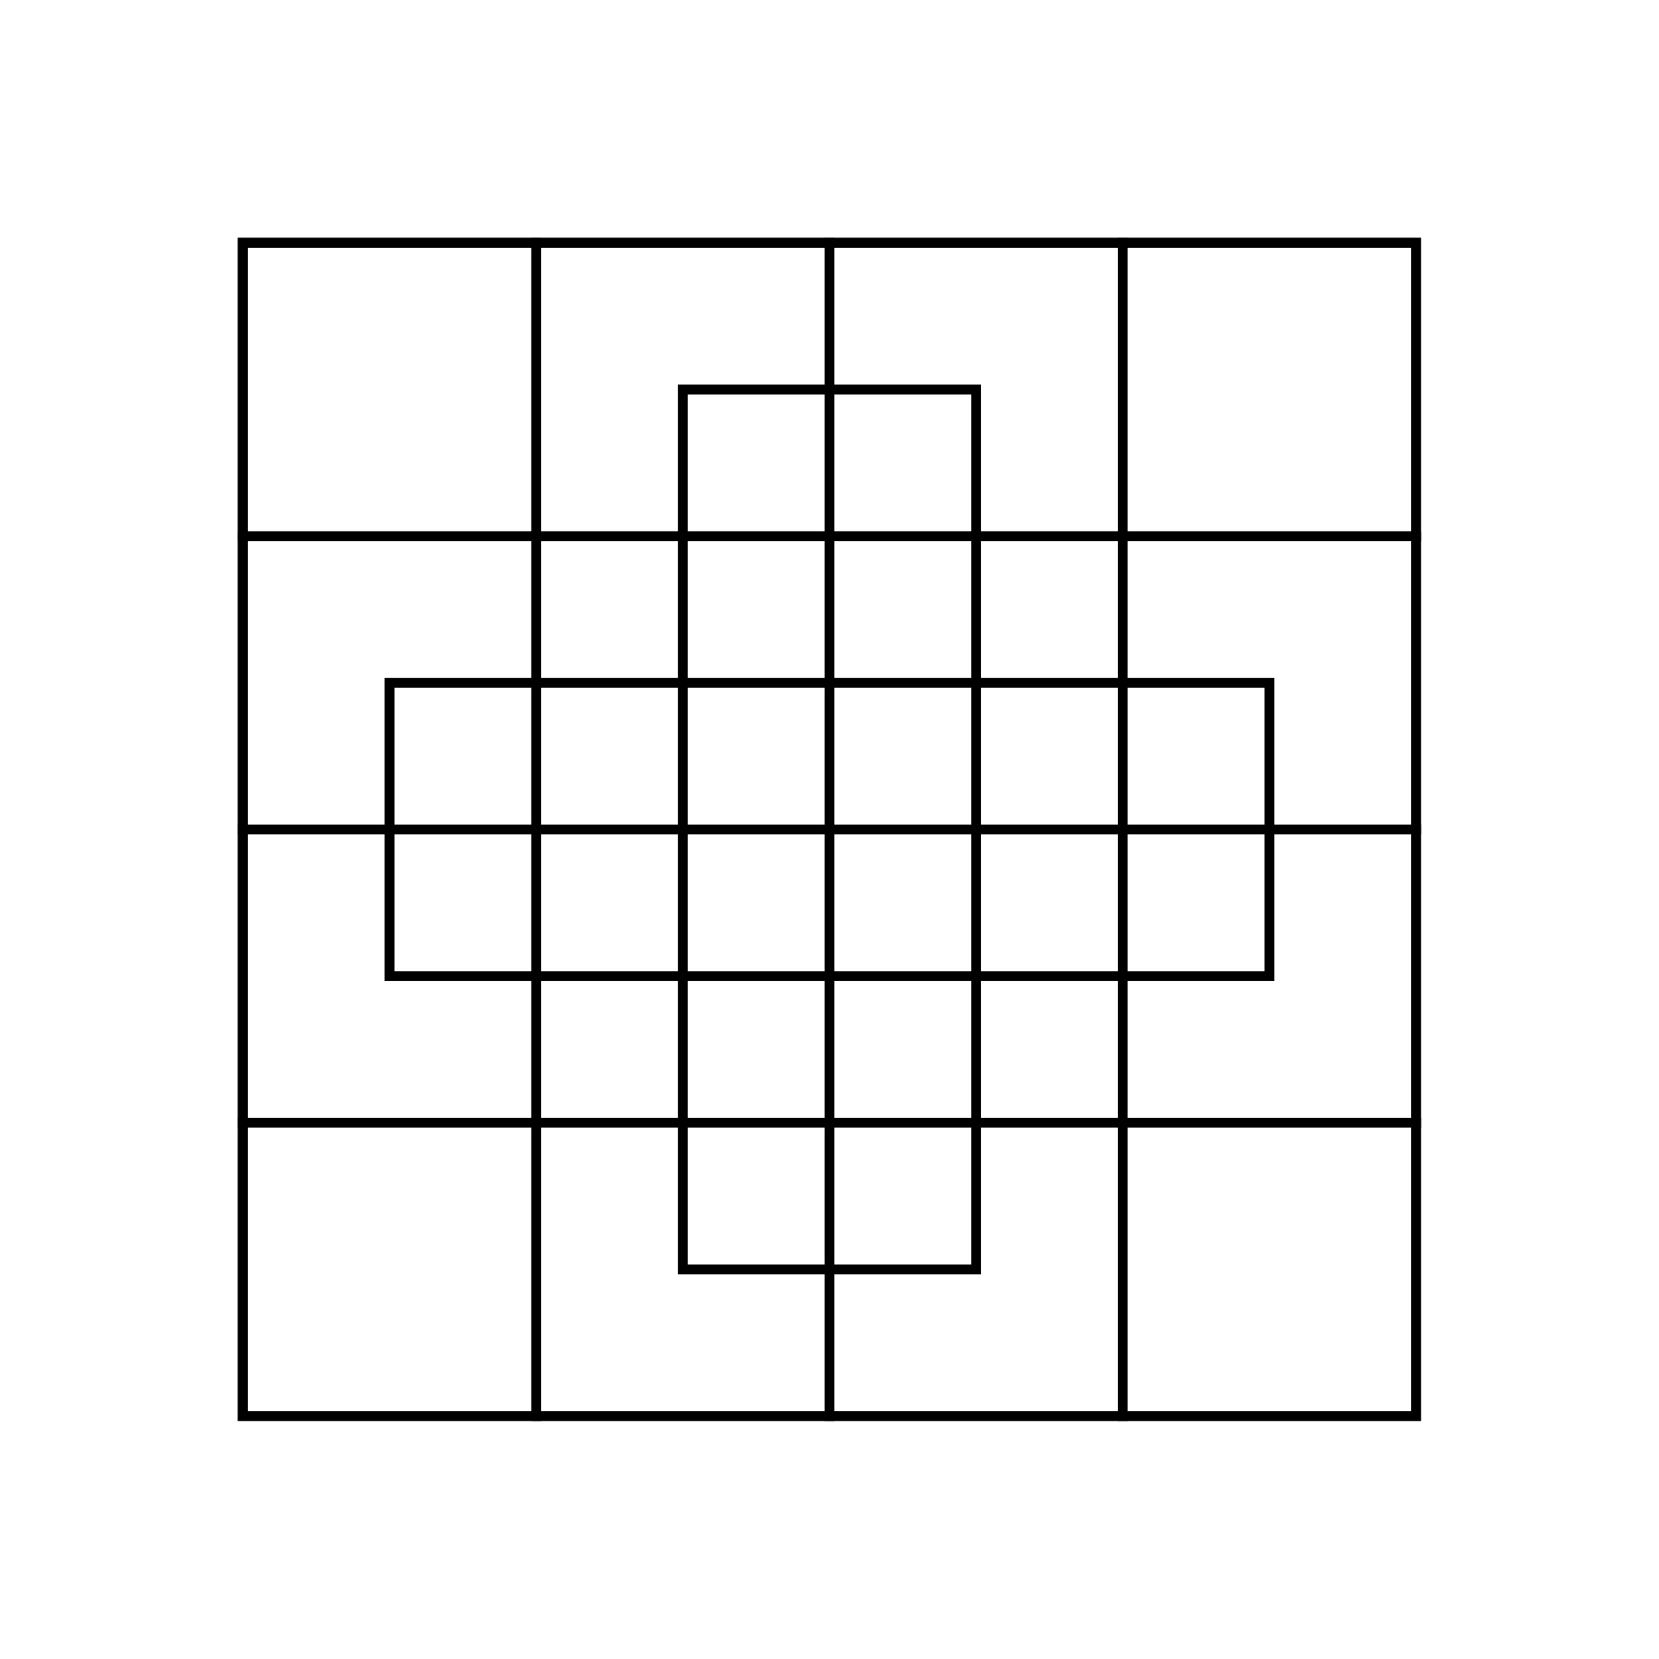
Puzzle 3

Slide 13
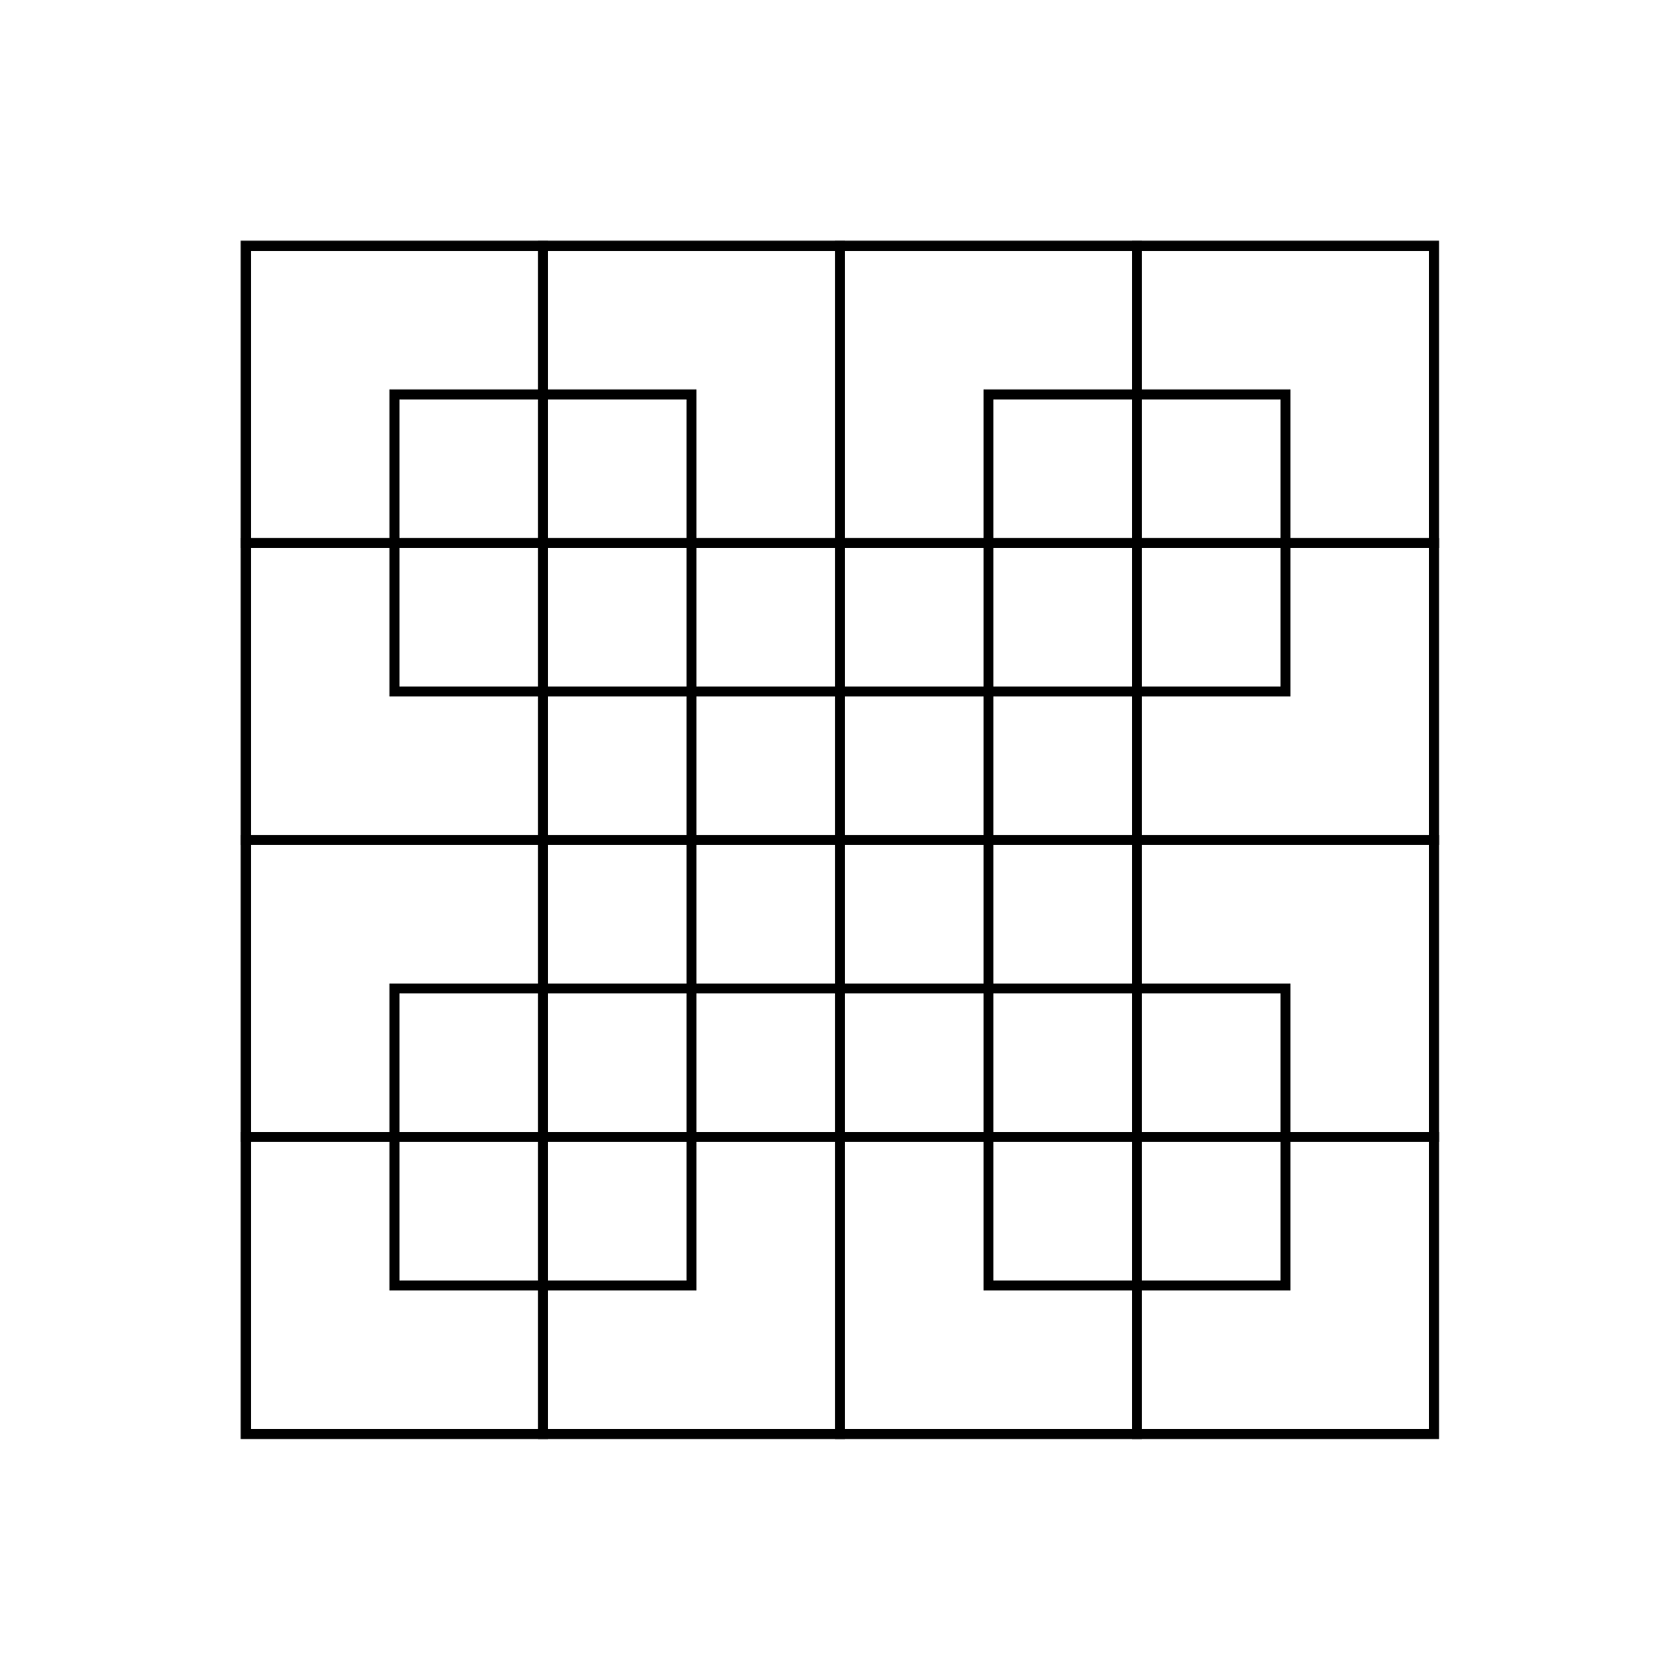
Puzzle 4

Slide 14
Discuss
What challenged you with this activity?
What were ways you were skeptical? What questions did you ask your partner when being skeptical?
What were ways that you deepened your understanding? What helped you to deepen your understanding?

Slide 15
Reflection
Did it help you to have a partner that was skeptical? How?
Did it help you to be skeptical? How?

Slide 16
There are 8 squares in this image. How do you see them?

Slide 17

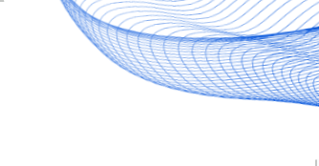

Love this task?
Join us for a workshop!
We offer a range of online and in-person professional learning opportunities! Explore here and get inspired by the joy of learning maths.
Note: we do charge a fee for our workshops, which is the main way that we fund youcubed, and most schools will cover the cost as part of their professional development budgets. To register using a purchase order, inquire about scholarships or ask a question about our workshops, please send an email to: pdinfo@youcubed.org
You can also support our work by donating here
This work is licensed under the Creative Commons Attribution-NonCommercial 4.0 International License.
To view a copy of this license, visit http://creativecommons.org/licenses/by-nc/4.0/

